Slide 1
ALY6110 DATA MANAGEMENT AND BIG DATA FINAL PROJECT
GRAPH ANALYTICS ON VIDEO GAMES USING NEO4j
Done by – GROUP 1
1. SHIKSHA ARORA
2. AMAN WANGDE
3. MENGI LU
4. XINKANG WANG
5. HARIPRASATH PERIYASAMY
Guided by
Professor Dr. Ricardo Checchi

Slide 2
Introduction
Overview about Graph Analytics on Video Games
Neo4j for Graph Analytics

Slide 3
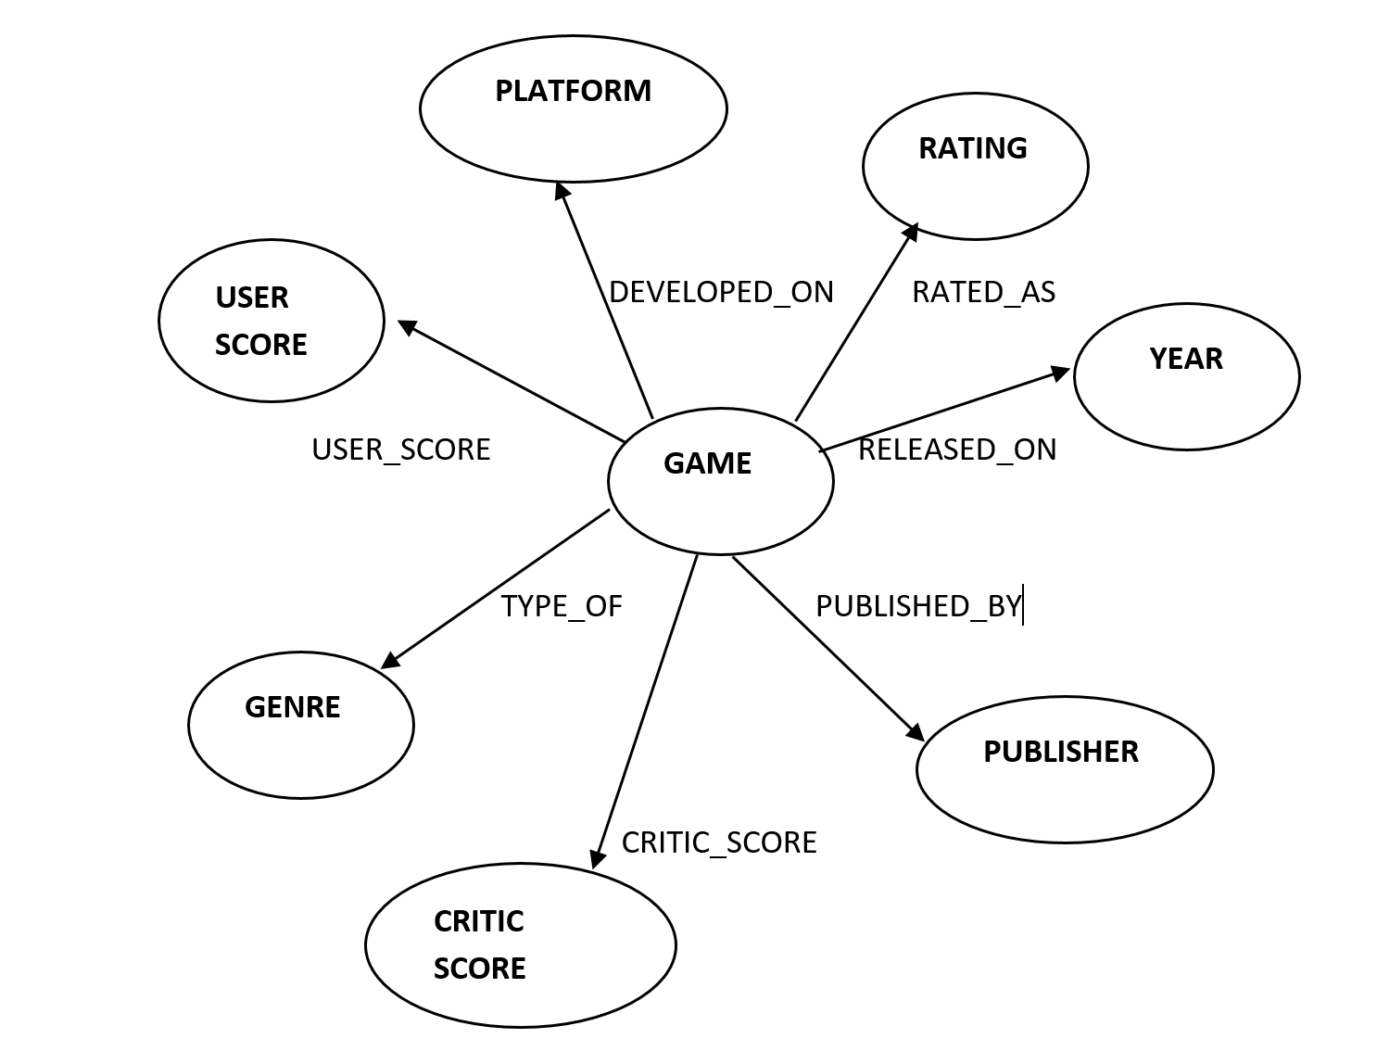
Graph of Video Games with Relationships

Slide 4
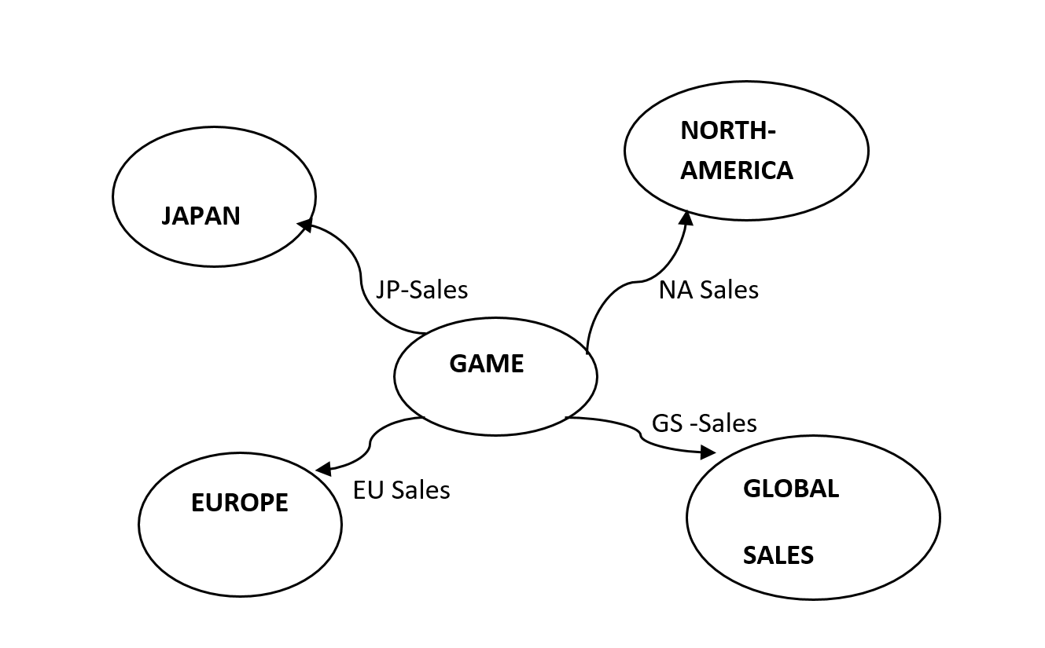
Games vs Sales

Slide 5
Analysis

Slide 6
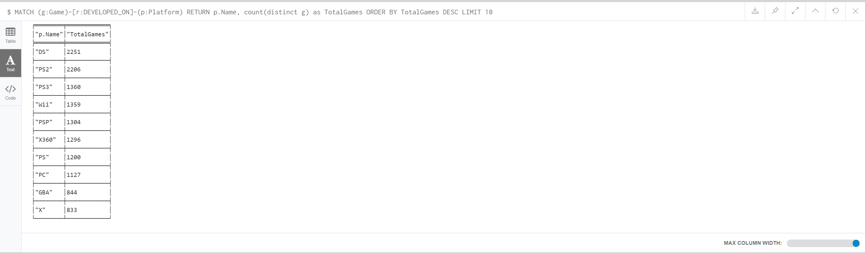
Game vs Platform

Slide 7
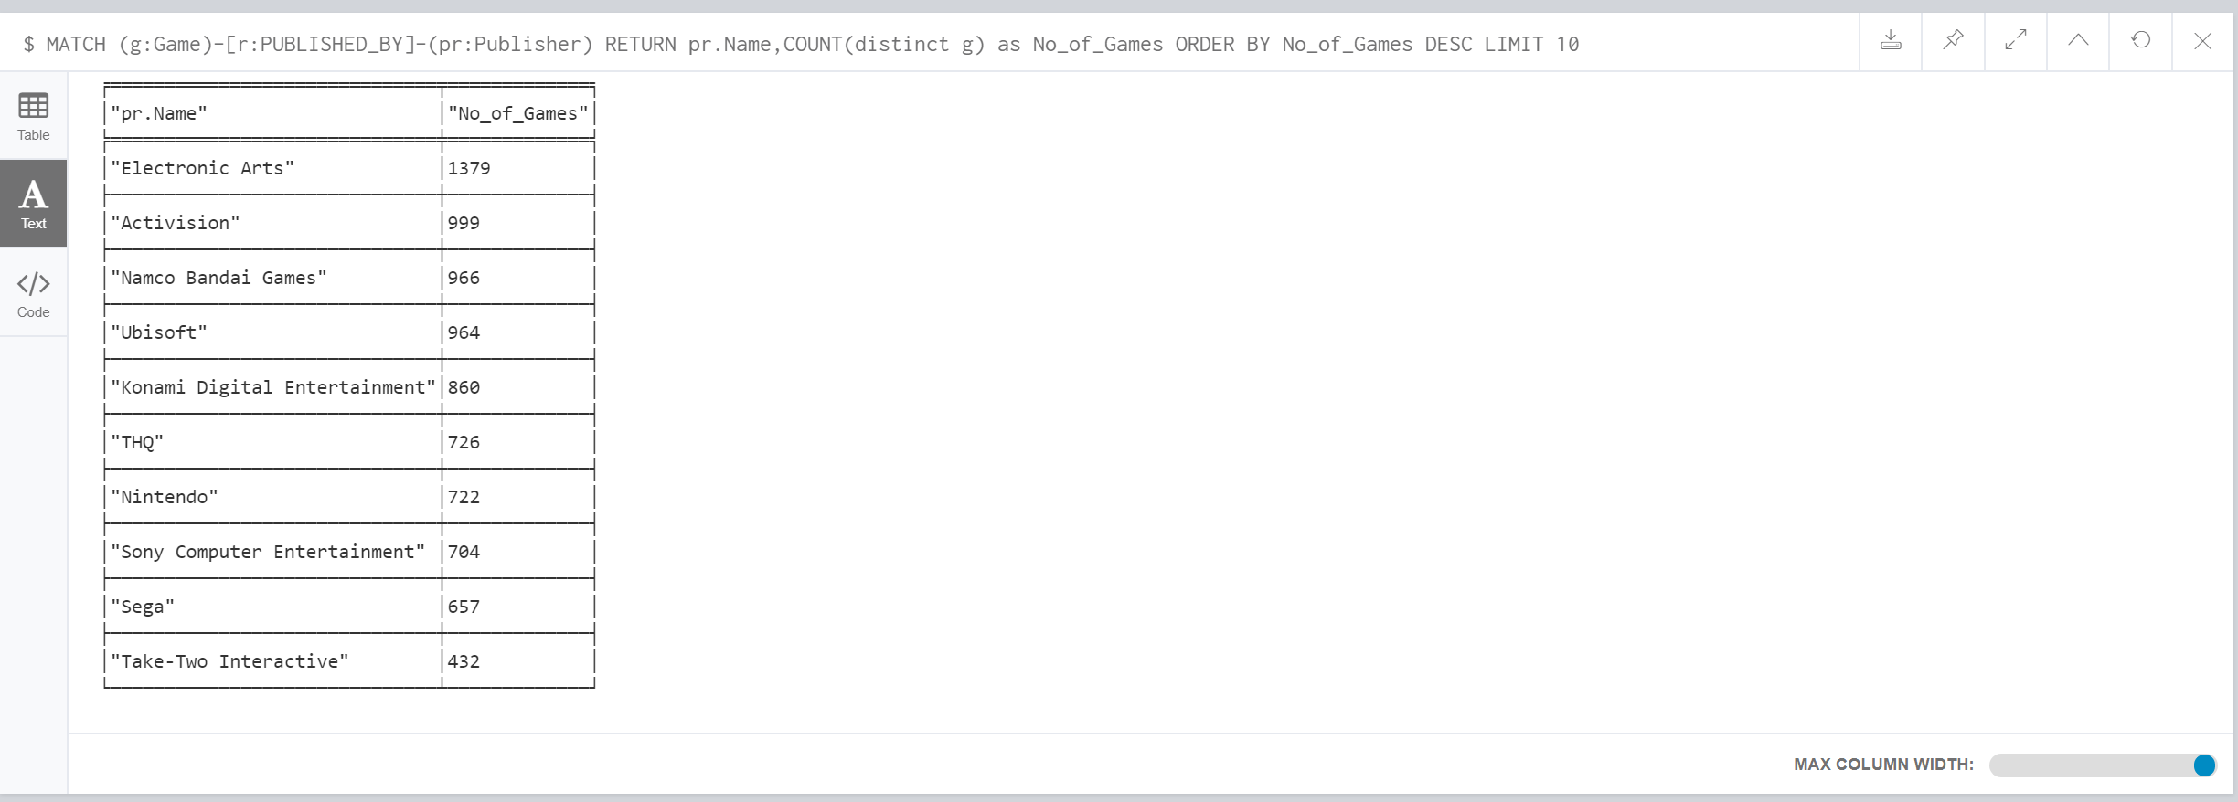
Game to Publisher

Slide 8
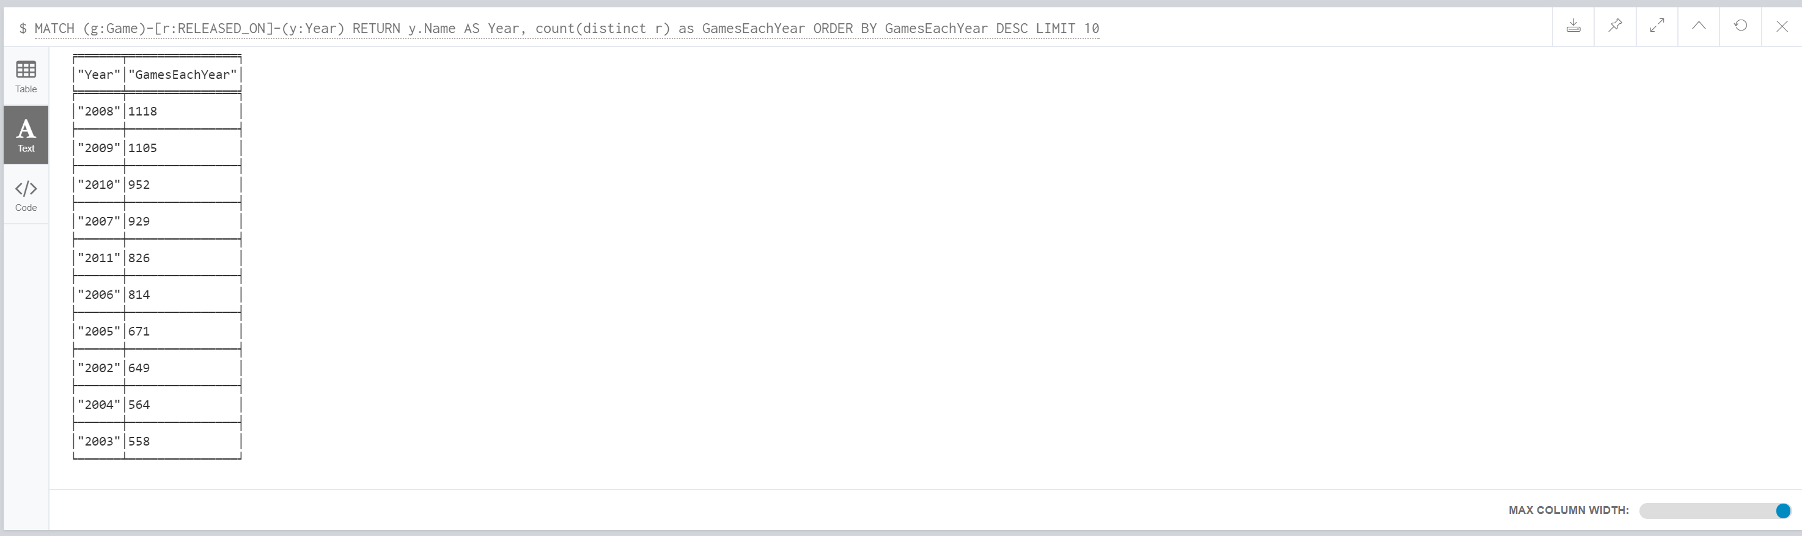
Game to Year

Slide 9
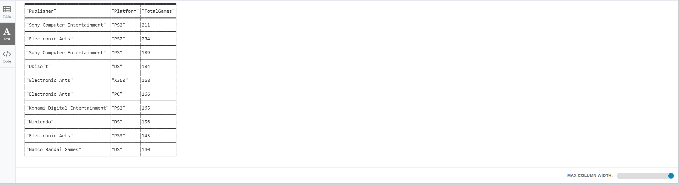
Publisher to Platform

Slide 10
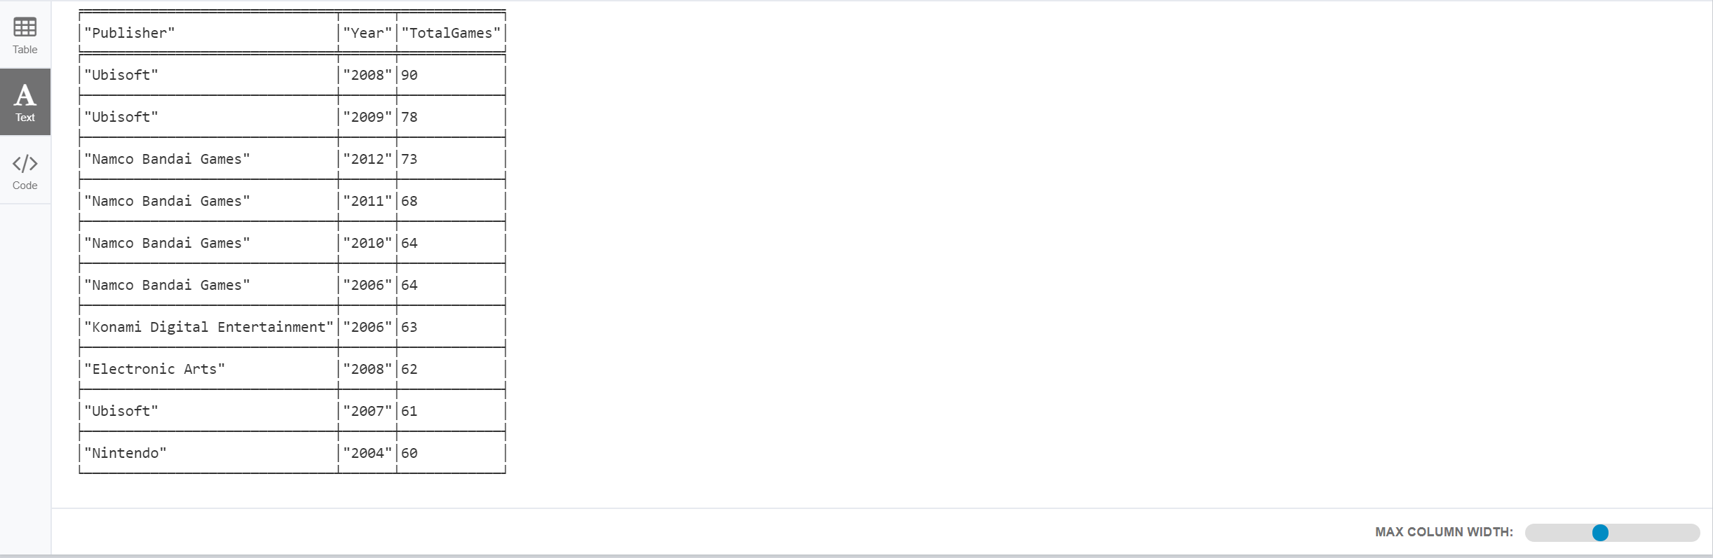
Publisher to Year

Slide 11
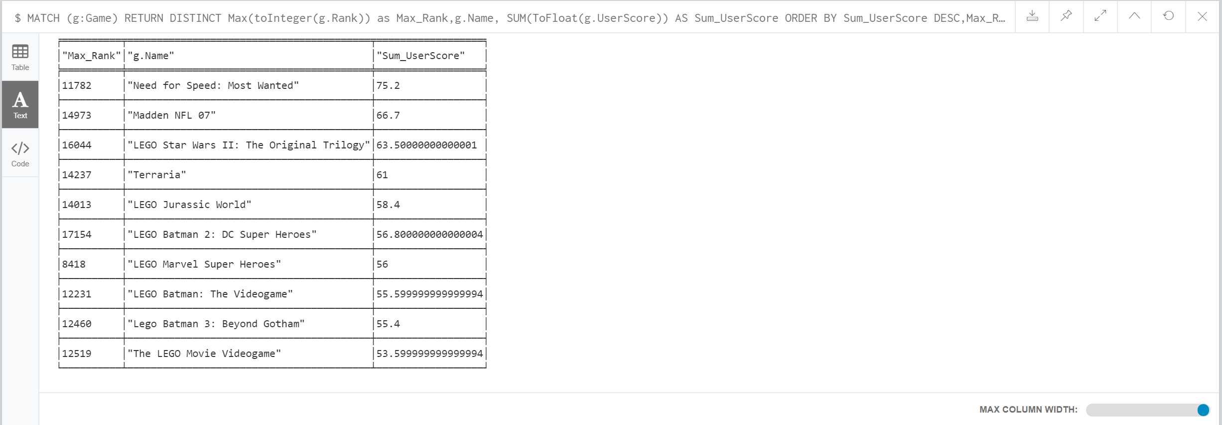
User Score vs Rank

Slide 12
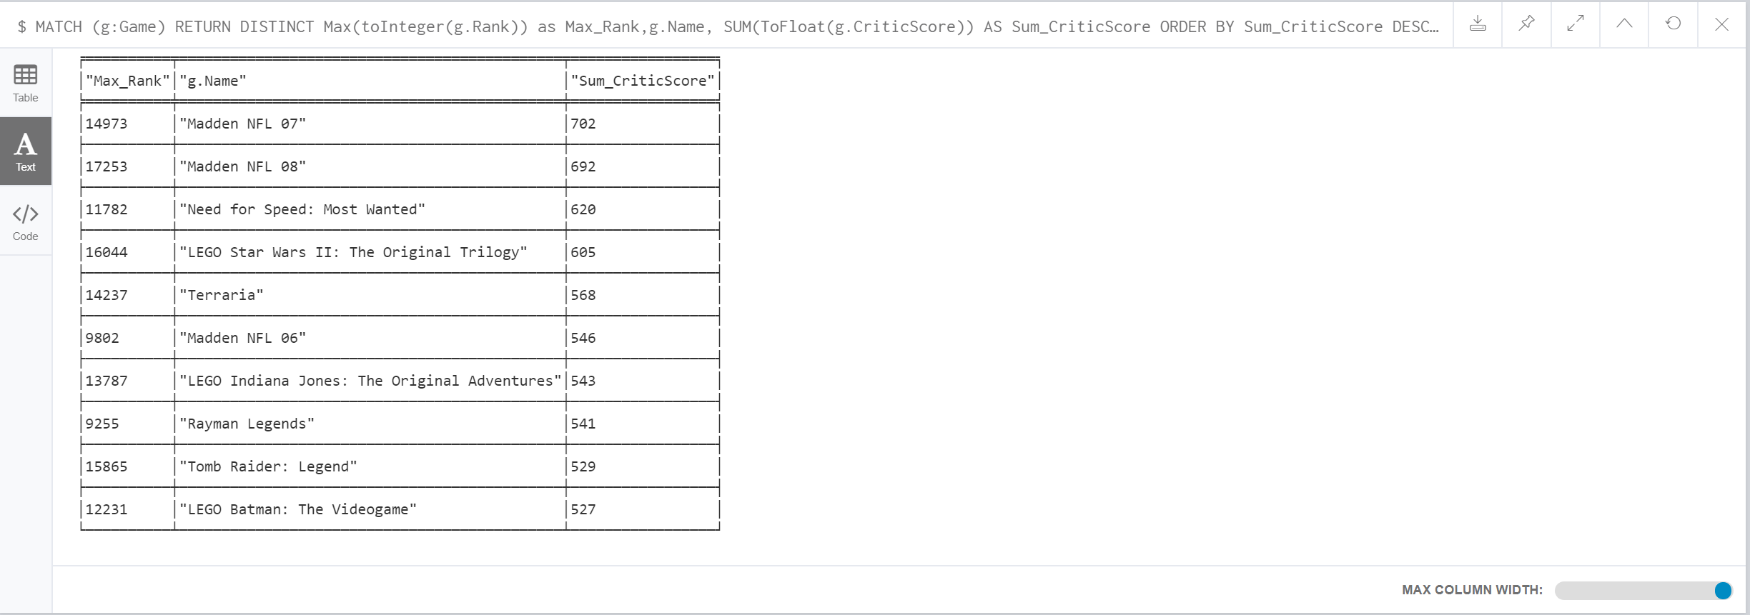
Critic Score vs Rank

Slide 13
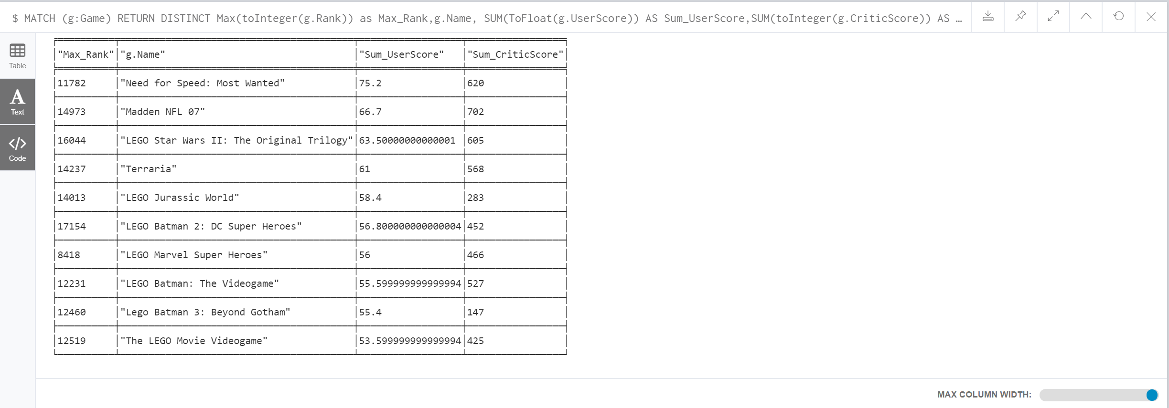
Final Inference of Rank, User Score & Critic Score

Slide 14
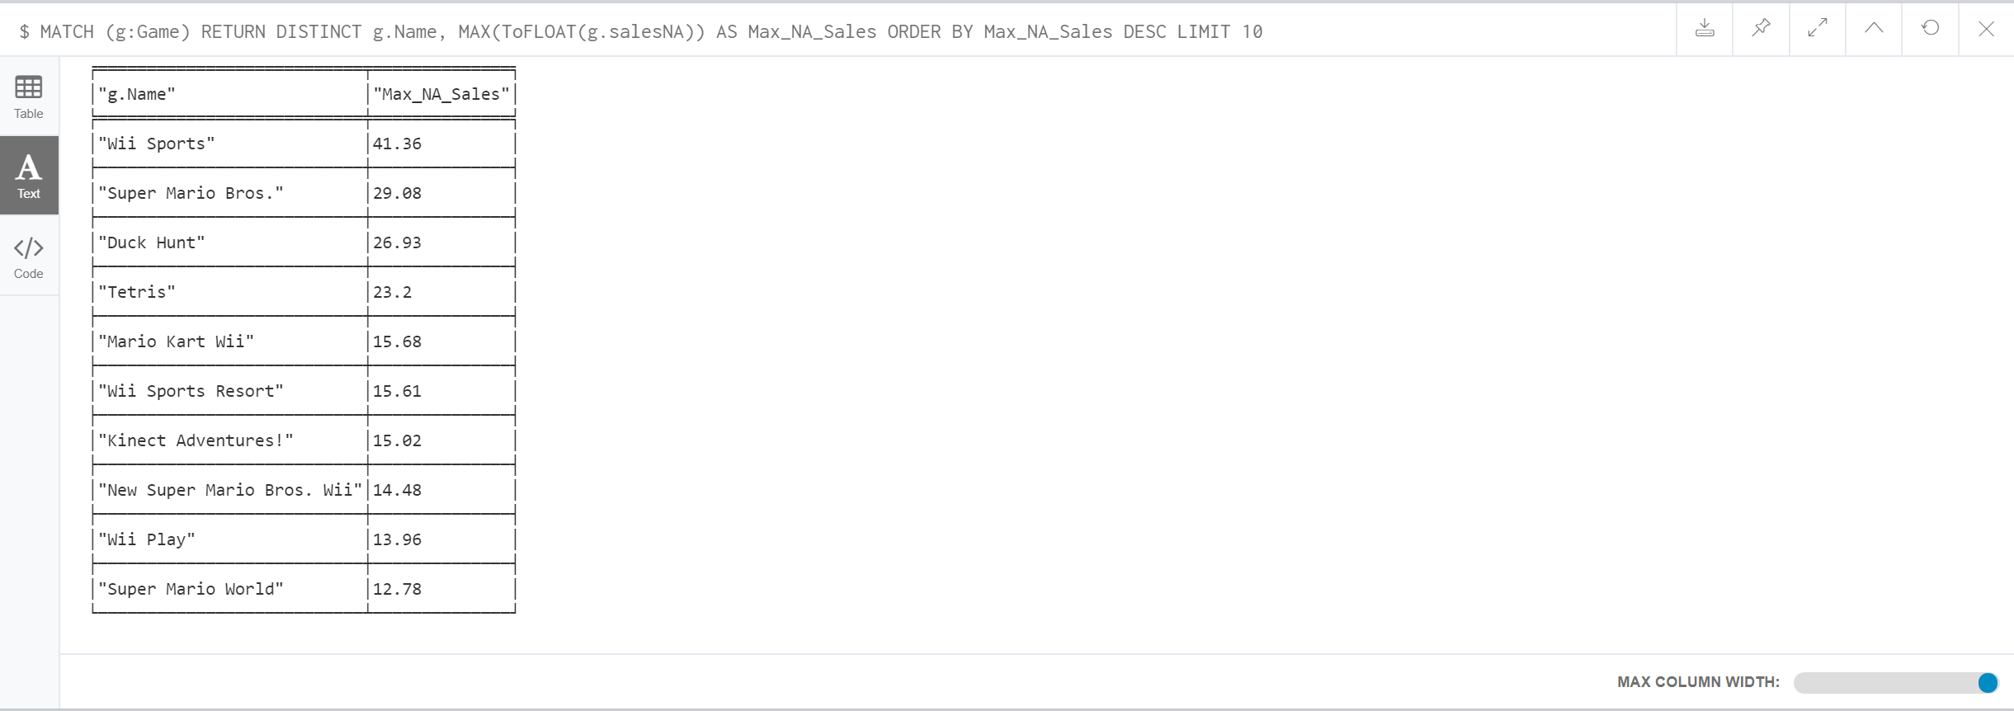
Games vs Sales

Slide 15
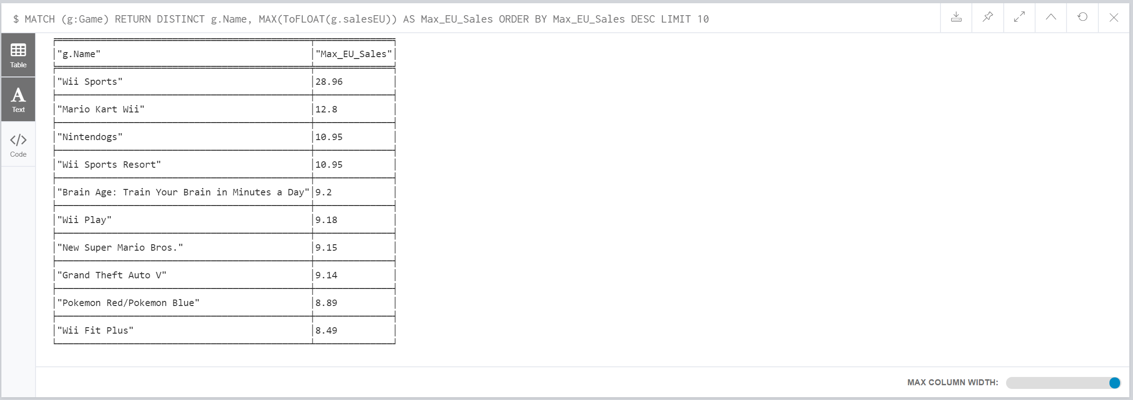
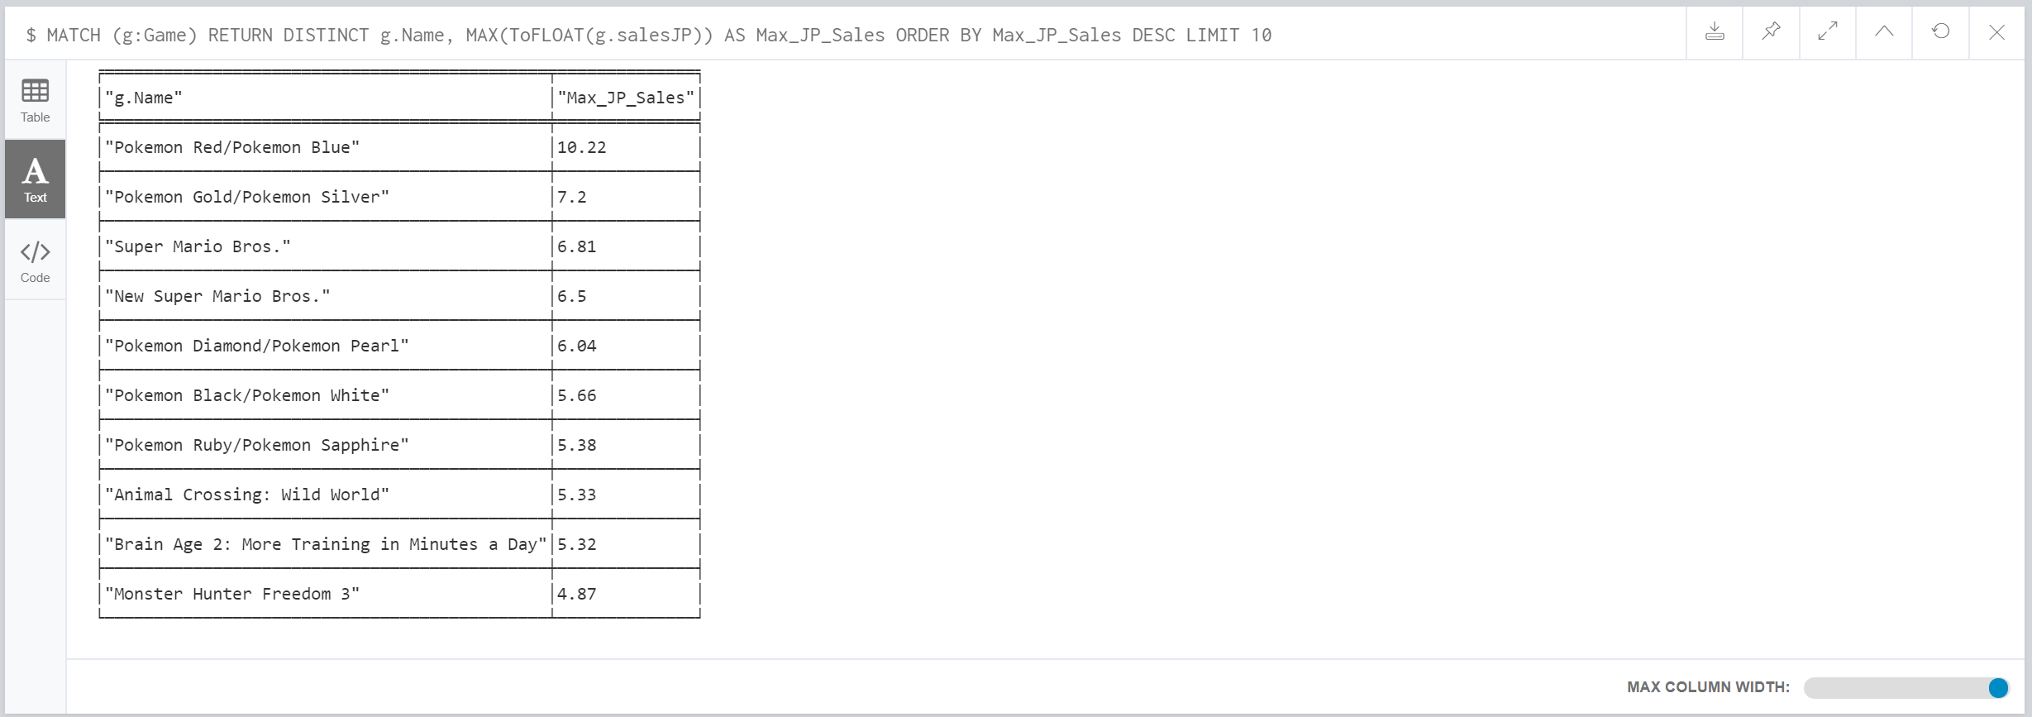
Sales in Europe & Japan

Slide 16
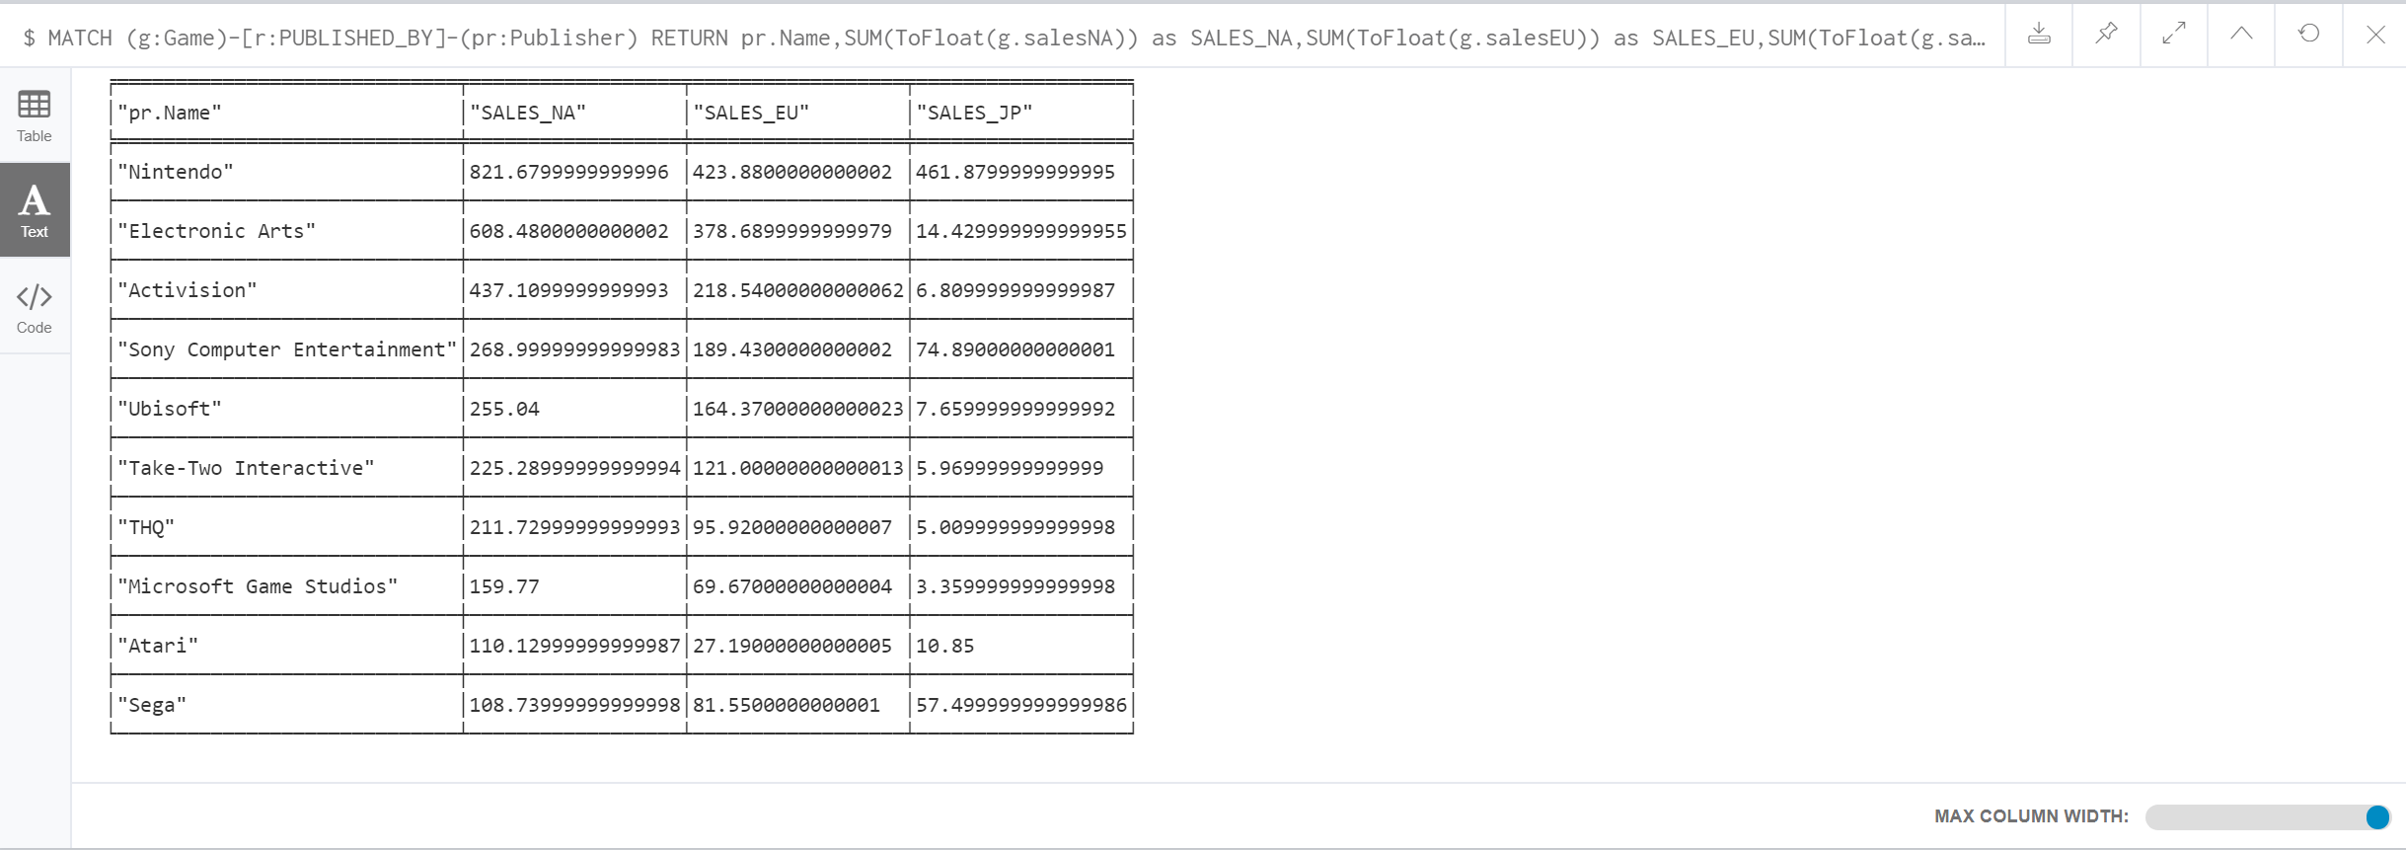
Publisher with Maximum Sales

Slide 17
Statistics for Overall Analysis -Tableau

Slide 18
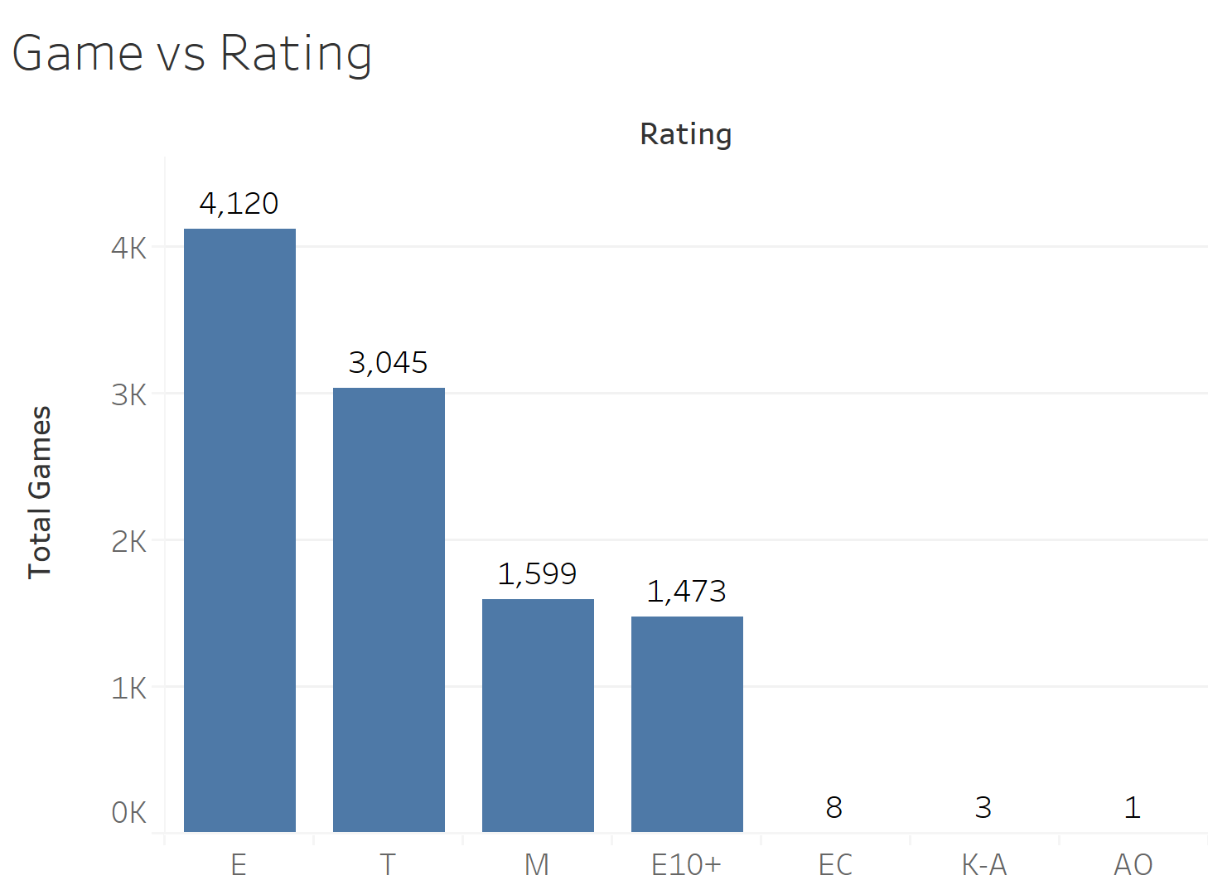

Slide 19
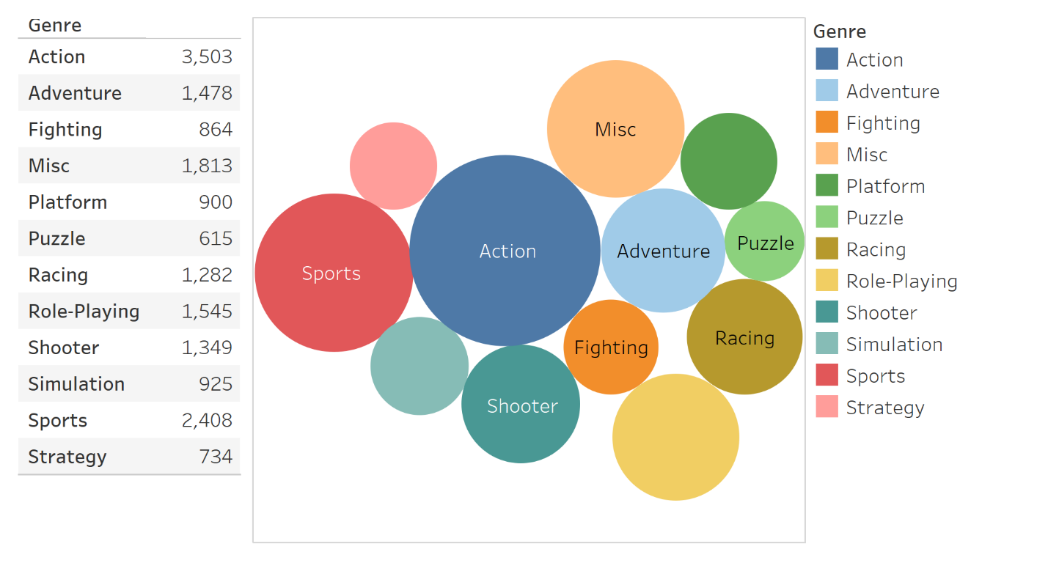

Slide 20
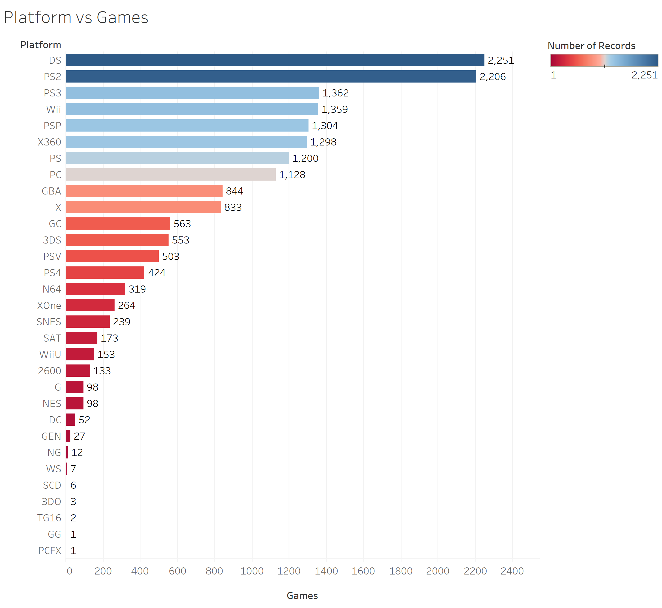

Slide 21
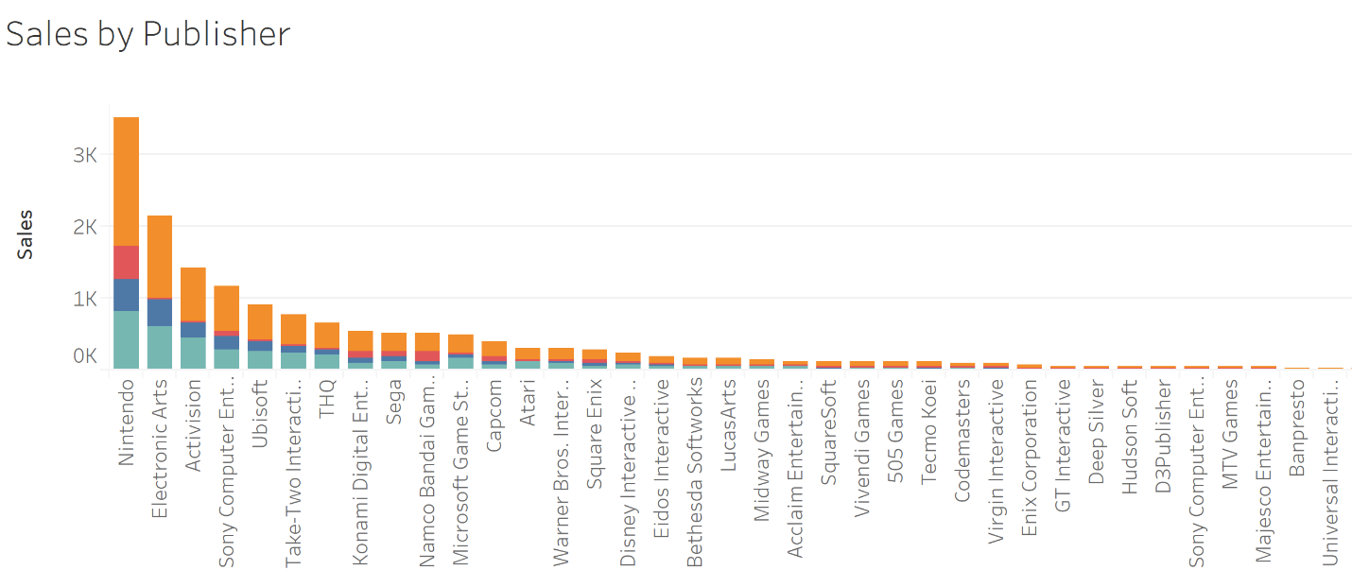
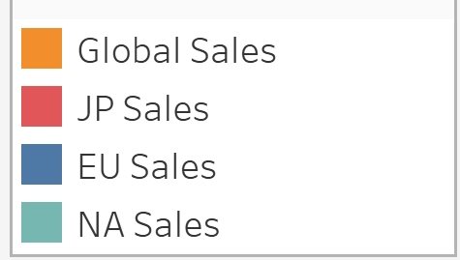

Slide 22
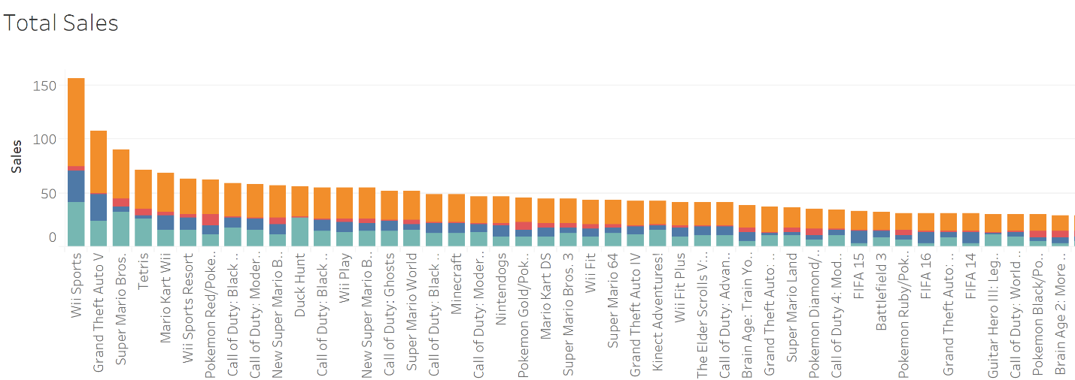

Slide 23
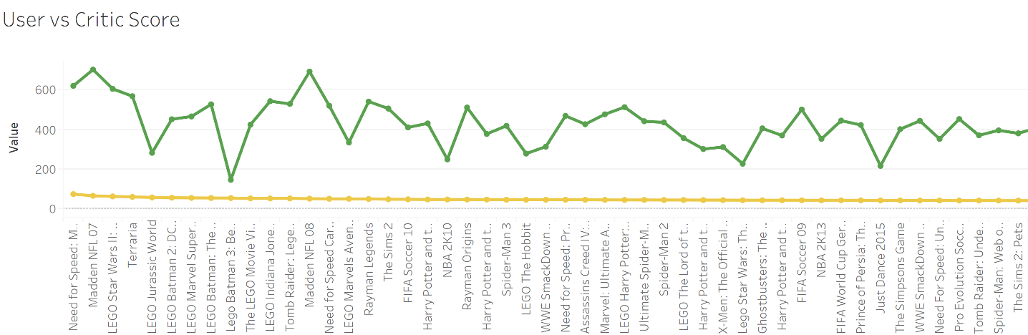
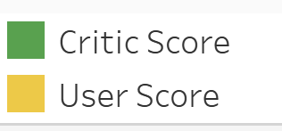

Slide 24
THANK YOU!!!

